Slide 1

Yelp & Yelping
A PROJECT to aid and make yelp better for businesses and Reviewers
Aditya Kumar
Kailun Zhang
Shekha Saxena
Shivam Namdeo
Shruthi Parameshwar

Slide 2
Introduction
Our project focuses on analyzing and deriving various metrics. Our objective is to motivate reviewers to write more reviews through our analytics dashboard and help a business improve and provide them a global platform to analyze their position.

Slide 3
Questions to think about…
Are the businesses getting enough information on the reviewers patterns?
Are the reviewers getting enough motivation to Yep?

Slide 4


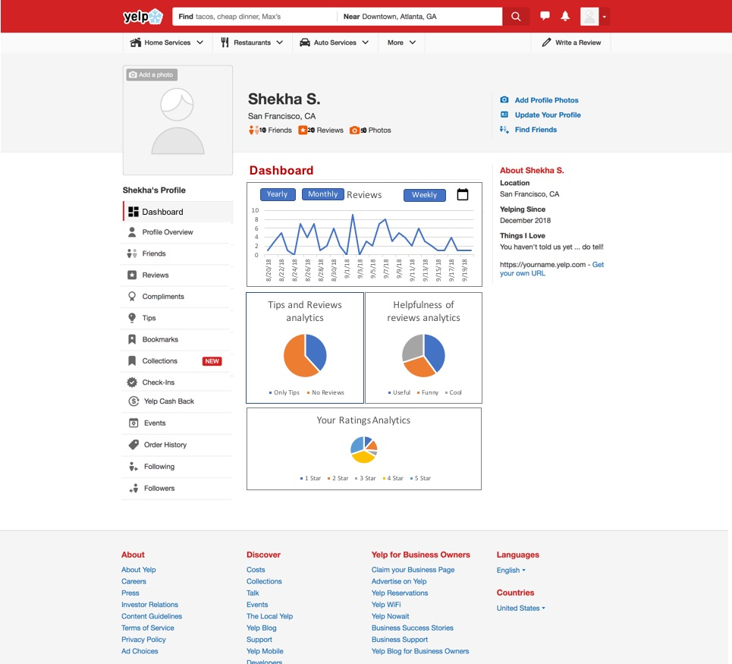



Website Design for Reviewers

Slide 5
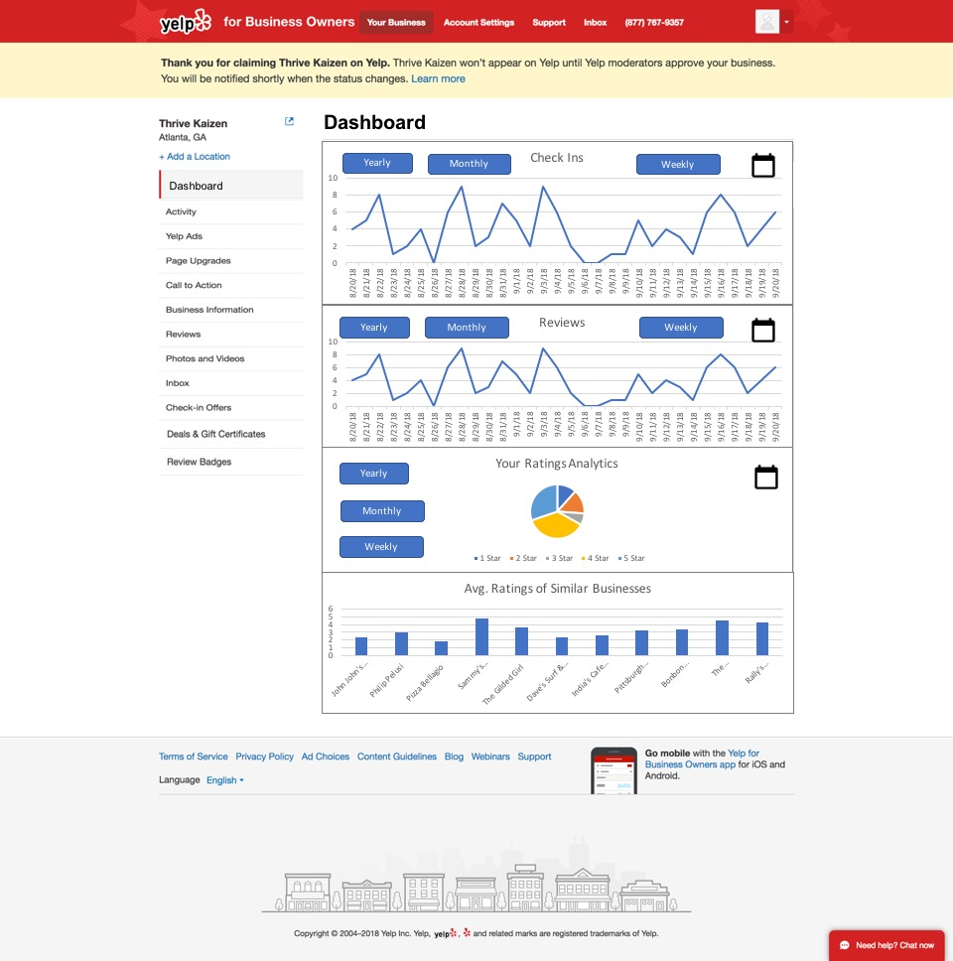
Website Design for Businesses

Slide 6
Mongo DB
Understanding Mongo DB Pseudo schema
Collections and validators
Data Cleaning
Sample insights drawn from the data

Slide 7
Mongo DB Pseudo schema
Collections Used
A) yelp_business
B) yelp_review
C) yelp_user
Embedded yelp_photos and yelp_tip in yelp_review
Embedded yelp_checkin in yelp_business

Slide 8
Data Cleaning
Data cleaning performed to filter out other cities and keep only two cities
Sample query used
db.yelp_business.find({city:{$in:["Cleveland","Pittsburgh"]}}).forEach(function(x){db.yelpNew _business.insert(x)});

Slide 9
Key insights drawn from the data
Sample insights-
Top 10 users with most number of likes on tips
Businesses which have most number of photos posted
Top 10 most prolific reviewers
The average number of reviews per business

Slide 10
BUSINESS VIEW
Business matrix: Top 10 most recent reviews , Average review star, reviewers who reviewed the same business, business with the most divergence in the ratings of reviews received
Implement:
Know how their services change in customer’s eyes
which business has most customers to visit or which business is the most popular one
How business is controversial

Slide 11
Reviewer view
User: helpful votes received, reviewer’s oldest review and newest review, the number of reviews, reviewers who reviewed a common set of business, the reviewer who has been reviewing for the longest period of time
Implement:
what kind of people prefer what kind of business
customers can easily pull out the newest review of their target business.
what kind of reviewer more likely to stay on our platform

Slide 12
Helpfulness of Reviews
non-text based
helpful votes that reviews receive, length of the reviews, helpful votes that reviewer receive
text based approach
there has been many instances where the reviewer provides positive feedback but provides a low helpful votes.
user error, bias or discrimination
sentiment analysis

Slide 13
Conformity
Social influence has for long been here
Does Yelp fall prey to this ?
Our dataset was no different

Slide 14
Geographical Proximity
Local businesses often face a challenge from the giant markets
How are businesses rated within a neighborhood?
Our data showed
Uniformity for about 12 neighborhoods
Which indicates that even though we have our reviewers falling into the mob, the ratings are mostly diverging which is a reason enough to sigh!

Slide 15
Text based analysis of User Reviews
Identifying one word reviews
Identifying reviews in the extreme ends of the spectrum
Trusting an older review
Analysing the profile of the reviewer
Analysing the geographical location of the reviewer

Slide 16
Text based analysis of User Reviews
The User reviews were analyzed using SAS Enterprise Miner with the aim to find out fake reviews from the genuine ones.
We ran a filter code on mongdb to separate the data of Pittsburgh and Cleveland so as to perform analysis on it.
This CSV file was then converted into SAS Data Format and loaded on the SAS Text Miner.
This Data was then passed through a text mining pipeline which consisted of following nodes:
TextParser, TextFilter, TextTopic and Text Cluster

Slide 17
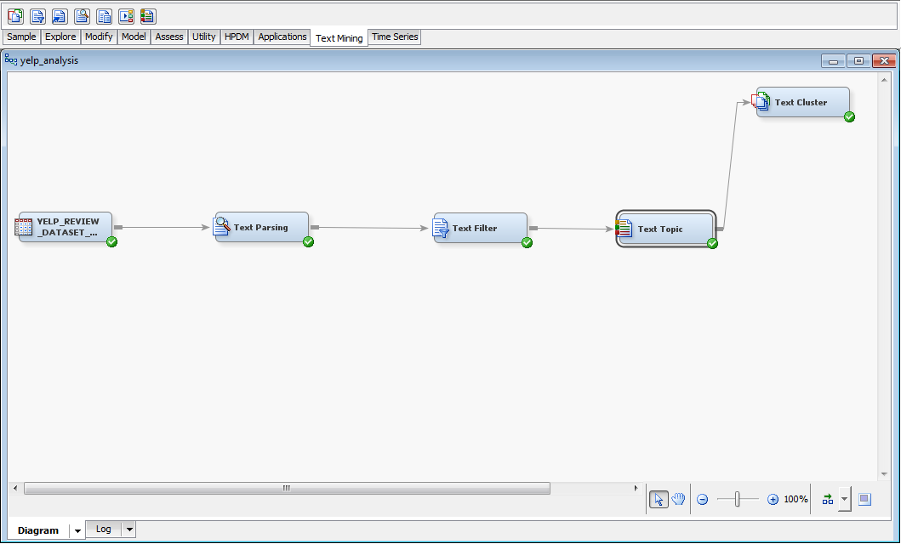
Text based analysis of User Reviews

Slide 18
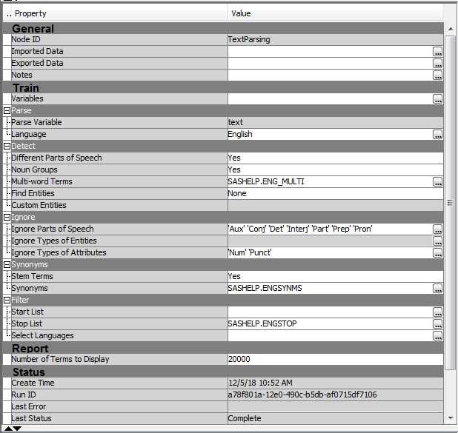
Text Parsing Node

Slide 19
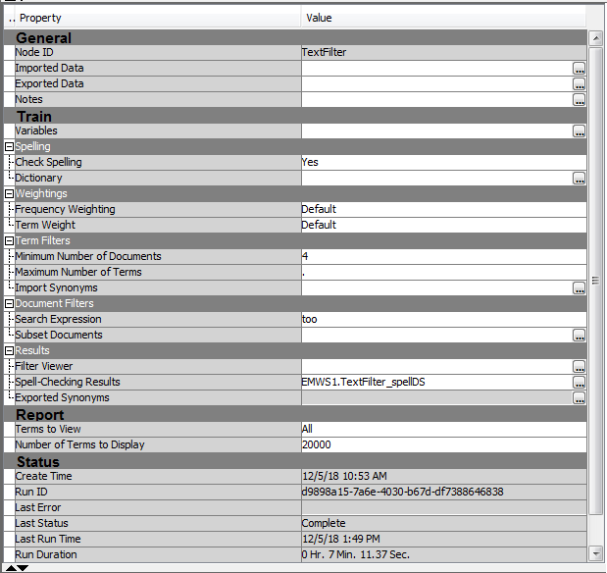
Text Filter Node

Slide 20
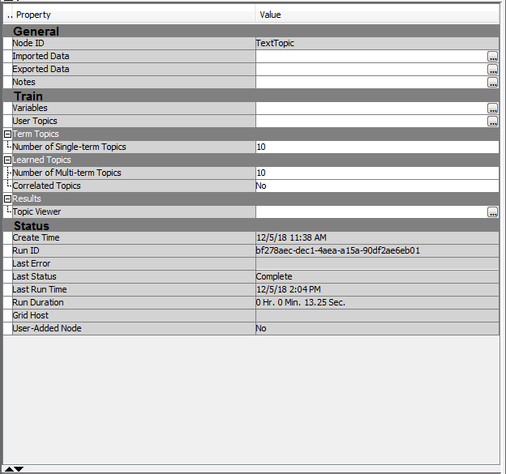
Text Topic Node

Slide 21
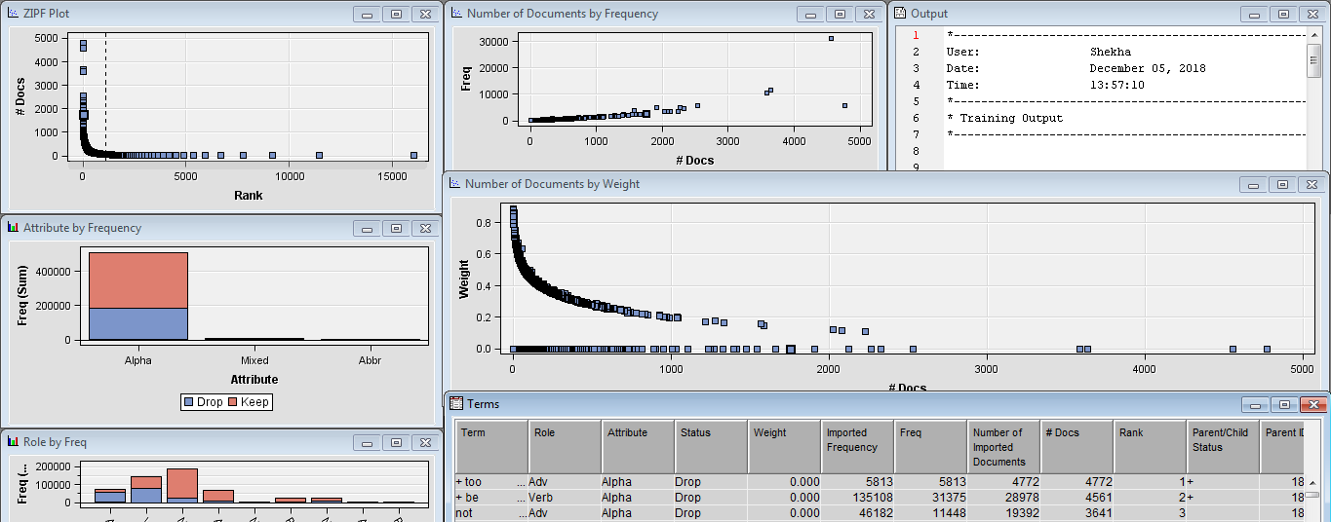
Text Filter Output

Slide 22
Thank You !

